Slide 1
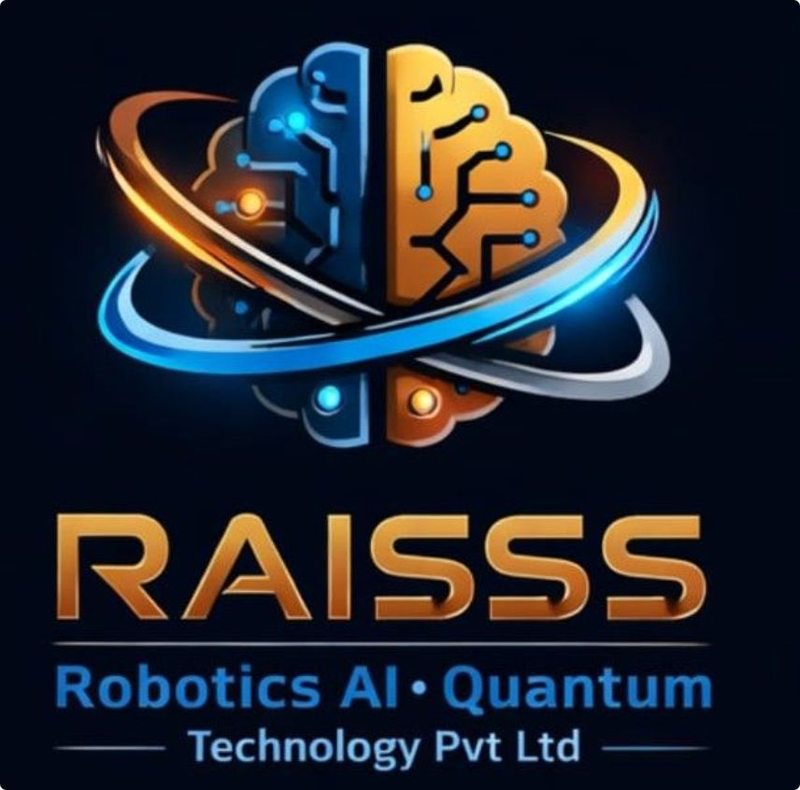
RAISSS Robotics AI and Quantum Technology
Innovating Today. Engineering Tomorrow.
DRONES
AGRICULTURE
ROBOTICS
AI
AUTONOMOUS SYSTEMS
QUANTUM TECHNOLOGY
Akola, Maharashtra, India | Incorporated January 2026

Slide 2

Who We Are
RAISSS is an indigenous deep-tech engineering and manufacturing company built entirely from the ground up in India. We develop hardware, software, AI, robotics, autonomous systems, and advanced engineering solutions. Our focus is on creating integrated technologies that turn ideas into real-world systems.
Six Core Technology Domains
Drones
Agriculture
Robotics
Artificial Intelligence
Autonomous Systems
Quantum Technology

Slide 3

The Challenge & Our Approach
The Challenge
Our Solution
Heavy dependence on imported technology in critical sectors
Limited intelligent automation across agriculture and industry
Slow adoption of precision agriculture and autonomous systems
Build indigenous platforms from the ground up in India
Integrate hardware, software, AI, robotics, and autonomy end-to-end
Deliver practical systems for research, manufacturing, and deployment
Most Critical Insight
India’s capability gap is also the biggest opportunity: RAISSS can create self-reliant, intelligent technology platforms where demand is high and local alternatives are limited.

Slide 4
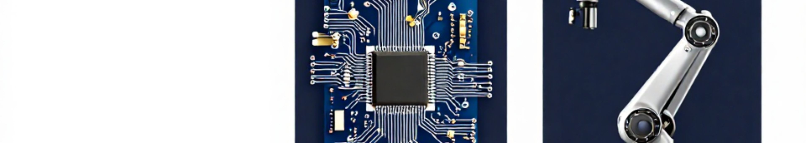
The Core Technology Pillars
Six integrated focus areas form one unified engineering ecosystem.
DRONES
AGRICULTURE
ROBOTICS
AI
AUTONOMOUS SYSTEMS
QUANTUM TECHNOLOGY
These domains are deliberately integrated to compound capability, not operate as silos.

Slide 5
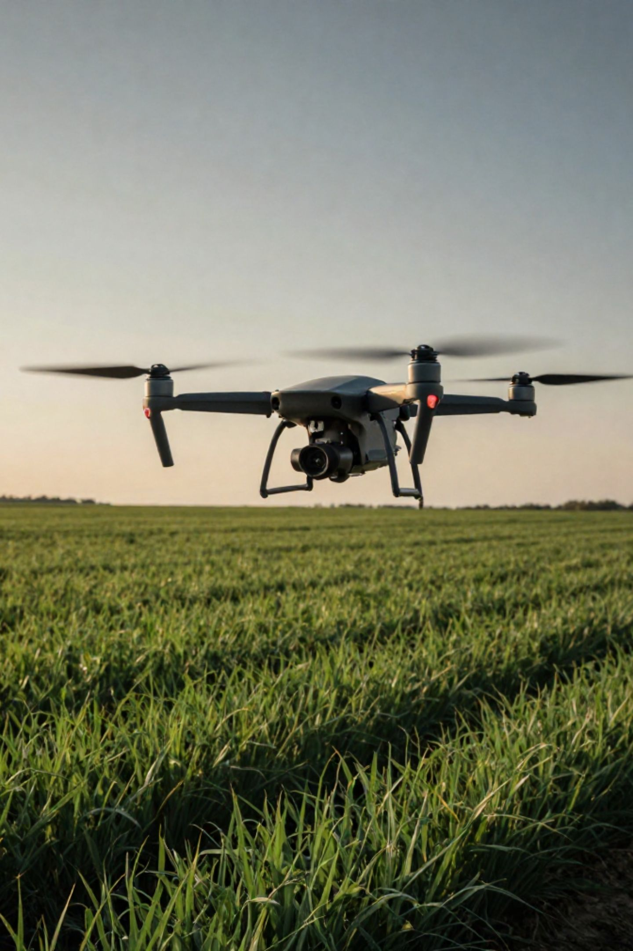
Drones & Precision Agriculture
Drone Engineering
Agricultural Applications
Data Pipeline
In-house development: concept to manufacturing
Autonomous capability: AI, sensors, navigation
Field-ready platforms: built for deployment
01
Precision spraying
Crop health monitoring
Field assessment
Aerial mapping
Capture
02
Analyze
03
Understand
04
Act

Slide 6
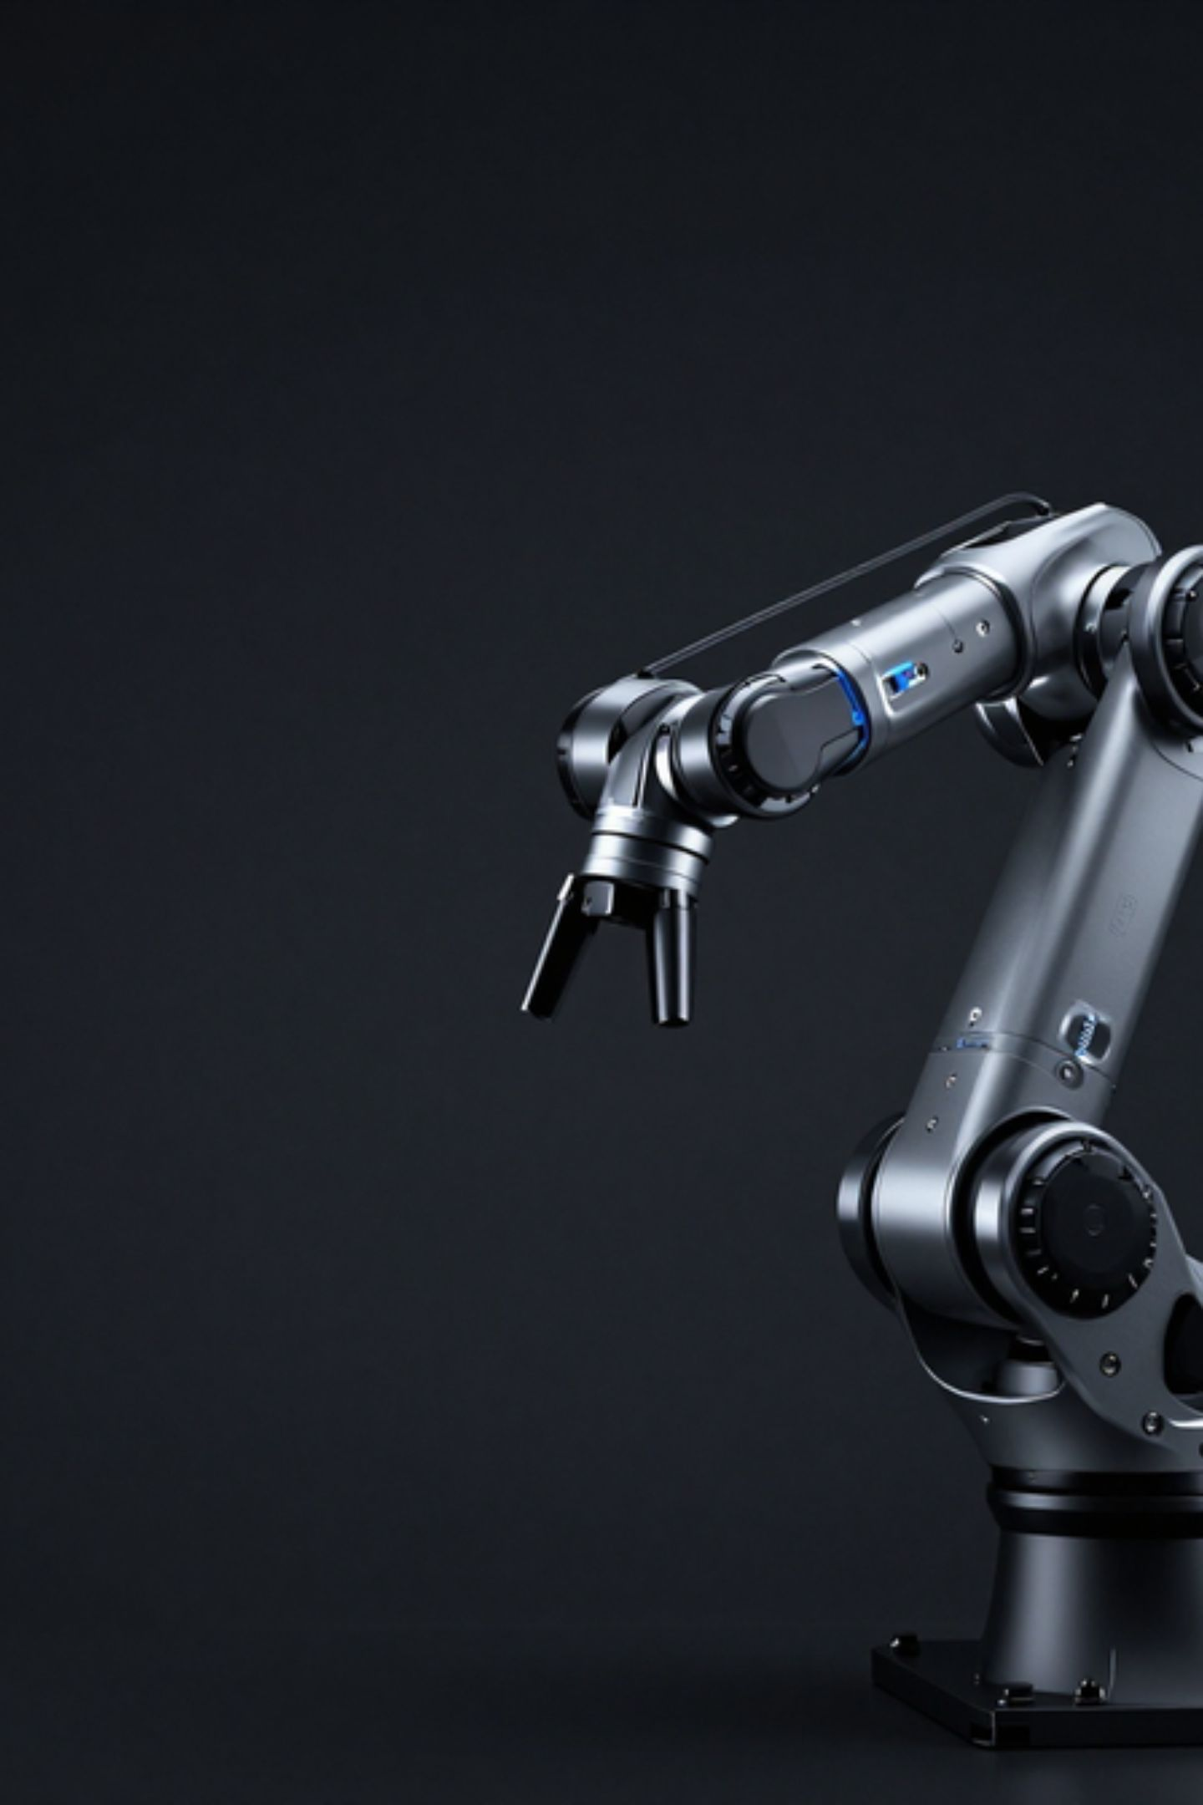
Robotics, AI & Autonomous Systems
Robotics & AI
Autonomous Systems Stack
Industrial Automation — Smart robotic systems for manufacturing and process control
Autonomous Operation — Self-directed systems with minimal human intervention
Human-Machine Interaction — Collaborative interfaces and control frameworks
Computer Vision & Decision Logic — Perception, analysis, and adaptive control
Sensors
AI
Navigation
Control
Software
Development Status
Drones — Autonomous mission execution — Under development
Robotics — Intelligent automated operation — Prototype / R&D
Industrial Platforms — Autonomous process control — Concept

Slide 7

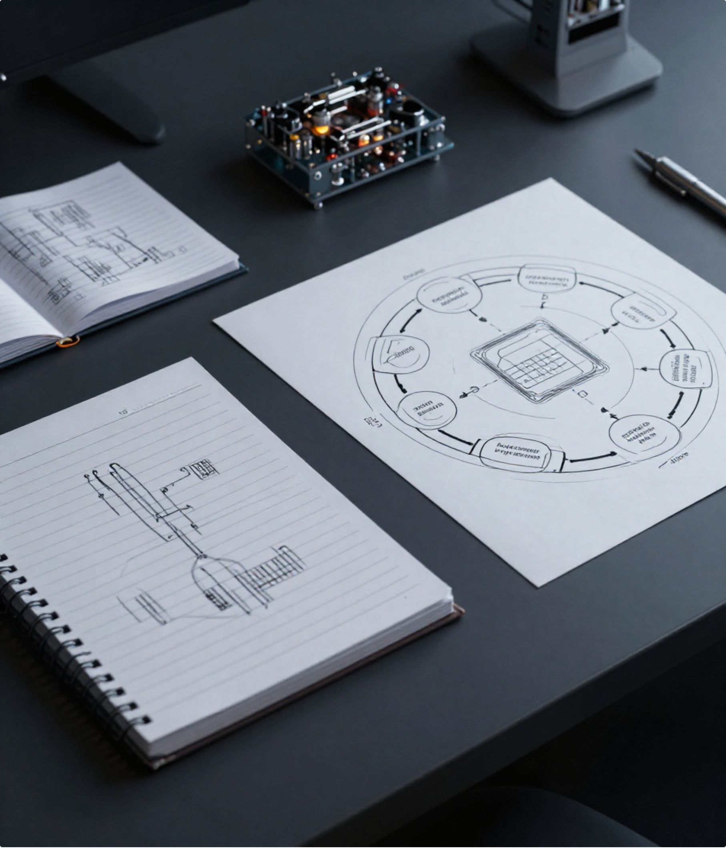


Quantum Technology & R&D Philosophy
Quantum Technology
R&D Innovation Cycle
01
Quantum Computing Fundamentals
Core principles, models, and future-ready computation.
Idea
02
Research
Quantum Algorithms
Exploring computational approaches for emerging use cases.
03
Engineering
04
Future Architecture
Long-term system design and capability research.
Prototype
05
Testing
Status: Exploratory research — no quantum hardware ownership claimed.
06
Learning

Slide 8

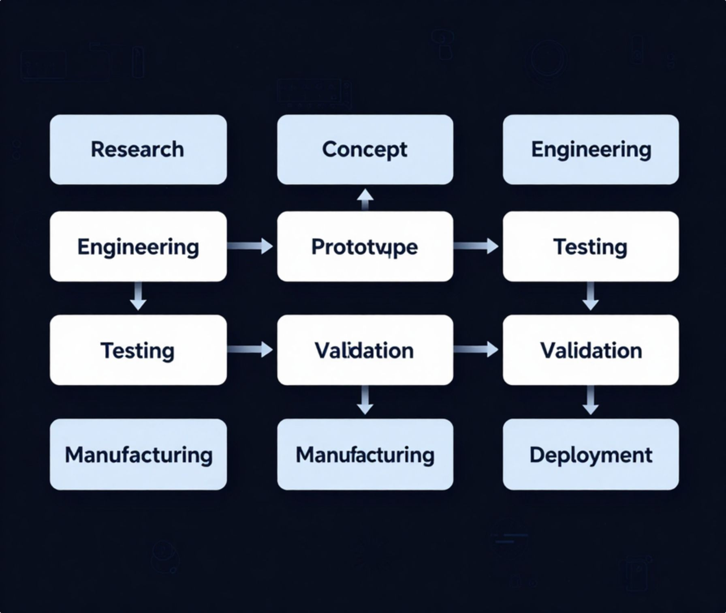
Engineering, Manufacturing & Product Development
Manufacturing Vision
8-Phase Development Pipeline
Product Ecosystem
Product engineering — design for manufacturability
Assembly systems — structured build processes
Electronics integration — PCB, embedded, sensors
Quality focus — testing and validation at every stage
Research
Drones & monitoring — agriculture, mapping, industrial
Robotics platforms — autonomous systems and hardware
Software & AI — control, analytics, and integration
1
2
Concept
3
Engineering
4
Prototype
5
Testing
6
Validation
7
Manufacturing
8
Deployment

Slide 9
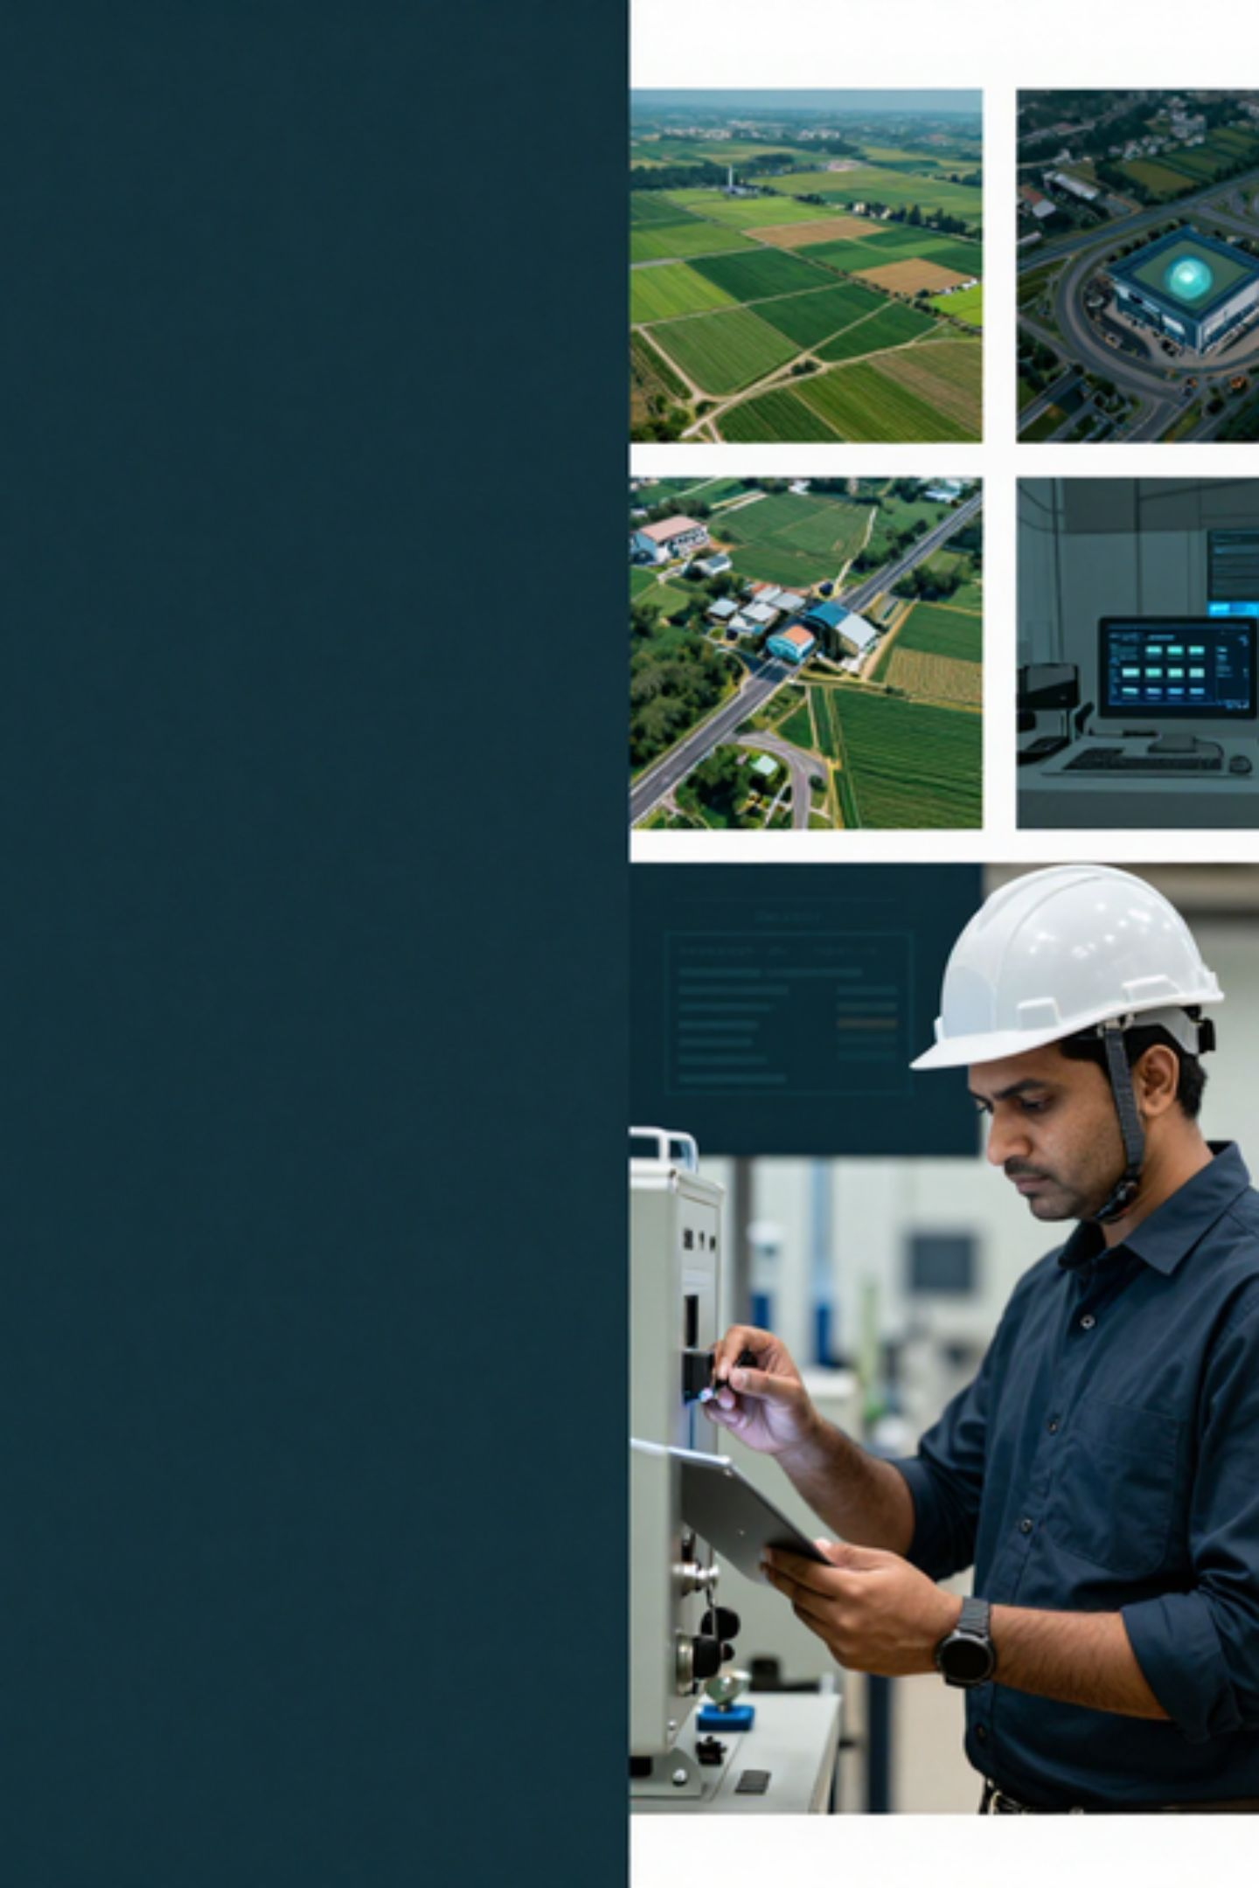
Industries, Partnerships & Roadmap
Industries We Serve
Partnerships
Roadmap
Technology partners
01
Agriculture
Component suppliers
Foundation Phase
Industrial
Research, engineering, prototyping, and internal capability building.
Manufacturing partners
Infrastructure
02
Research & academic institutions
Growth Phase
Mapping & Surveying
Deployment collaborators
Product validation, scaling manufacturing, and deployment readiness.
Monitoring
03
Education & Research
Long-Term Goal
Integrated, self-reliant technology ecosystem from research to deployment.
Robotics

Slide 10
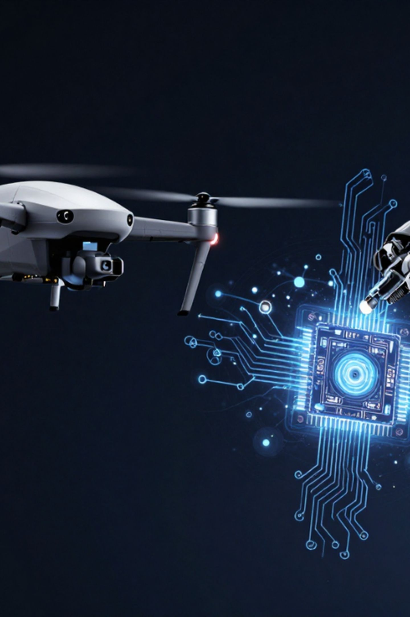
Building the Future of Intelligent Engineering
The future belongs to intelligent systems built through strong engineering.
Our Vision
What Sets Us Apart
Become a leading indigenous technology ecosystem spanning drones, robotics, AI, autonomous systems, and advanced computing. We drive sustainable innovation through rigorous engineering excellence and solutions that solve real-world challenges.
Indigenous technology focus — built in India, not dependent on imported platforms or foreign IP
Engineering-first mindset — rigorous design discipline from the start
R&D driven culture — concept to prototype to validated product
Manufacturing orientation — built to produce, not just design
Multi-disciplinary integration — six technology domains working as one
Long-term innovation roadmap — from foundation to ecosystem leadership
RAISSS Robotics AI and Quantum Technology Private Limited
Akola, Maharashtra, India
Innovating Today. Engineering Tomorrow.

